Slide 1
USMA CCDC

Slide 2
Task Organization
Team Leader Cho
Deputy Glazer
Operations Officer Fauerbach
Monitoring Team
TL: Cannon
Yarbrough
Perez
Walsh
Networking Team
TL: Soler
Yarbrough
Bann
Wilton
Systems Team
TL: Kunze
Shopov
Gelashvili
O’Neill
Services Team
TL: Villegas
Perez
Walsh
Wilton
Strike Team:
TL: Shopov
Gelashvili
Bann

Slide 3
Headquarters
Team Leader: Cho
Deputy Team Leader: Glazer
Operations Officer: Fauerbach

Slide 4
Mission
To educate, train, and prepare the USMA Collegiate Cyber Defense Competition team for the Collegiate Cyber Defense Competition on 27 January 2018 in order to win the competition and create the foundation for future teams.

Slide 5
Available Assets
Cisco Routers
Cisco Switches
Vsphere
EECS Net
Historical resources from previous CDX teams
All online or printed resources
I.e server-world.info, other FAQs
http://www.nationalccdc.org/index.php/competition/competitors/rules

Slide 6
Constraints
Time
Number of VMs allowed and max processing power for each
No paid resources
Lack of internet access
No external media

Slide 7
CCDC Essential Skill Set
• Common Unix Printing System (CUPS) • Computer Forensics • Database administration • Directory services (e.g., Active Directory) • Domain Name System (DNS) • E-mail Servers (Exchange and sendmail) • File Servers • File Transfer Protocol (FTP) services • Hacking Tools • HTML • Networking devices (to include switches, firewalls, routers) • Samba • Secure Shell (SSH) • SQL • Syslog • Understand Cyber Law • Virtual Private Networking (VPN)/remote access • Web servers (both Apache and IIS) • Windows and UNIX/Linux system administration and hardening

Slide 8
Risk Assessment
Multiple operating systems
Windows 2008/7, Windows 2003/2000 Server and Professional, Windows XP Professional, Windows Vista, Various BSD distributions, various Linux distributions, and Solaris
Diverse services
Analyze live traffic for malware
Inherit and Defend
Identify pre-installed backdoors
Troubleshooting
What does right look like

Slide 9
Tasks
Specified
Establish COA for next 12 lessons
Identify CCDC team for next semester (12 PAX)
Prepare reference material for services
Implied
Determine what we need to know for the CCDC
Reach out to mentors to learn additional skill sets

Slide 10
Timeline
Lesson | Date | Item
28 | 07 NOV 17 | Mission Analysis Brief
29 | 09 NOV 17 | Identify familiar and new services
30 | 14 NOV 17 | Identify tools and alternatives
31 | 16 NOV 17 | Special Equipment requests due
32 | 20 NOV 17 | Building systems from the ground up

Slide 11
Timeline
Lesson | Date | Item
33 | 22 NOV 17 | Left seat/right seat
34 | 28 NOV 17 | Pentest
35 | 30 NOV 17 | Alternates configure network
36 | 04 DEC17 | Fixing broken setups
37 | 06 DEC 17 | Pentest
38 | 08 DEC 17 | Formalize knowledge
39 | 12 DEC 17 | Backbrief and AAR

Slide 12
Systems Team
Team Leader: Kunze
Servers/SELinux (operate): Shopov
End-user Unix (sanitize): Gelashvili
End-user Windows (sanitize): O’Neill
Notes:
Cole - Make sure you discuss OS and the initialization of each VM.
This is focused on securing the actual base machine. So dealing with stuff like user accounts that aren’t supposed to be there, running apt-get update, looking for chron jobs, ports that are listening or beaconing. Basically making sure that the attacker actually has to exploit a bad config and not just log in

Slide 13
System Requests
Basic images:
RedHat/SELinux
VirtualBox
CentOS
Fedora Server
Risk Assessment:
Pre-installed vulnerabilities (rootkits, backdoors, unnecessary services)
Set up, configure, and harden: HTTP, SSH, FTP, RDP, Telnet, SSL, DNS, Certificates
Create users and groups and set security policy
Web, email, authentication services

Slide 14
Windows Machine
Before receiving graycell image:
Learn how to use FTK imager, autoruns, and process hacker, and be able to install and run SCAP
Identify the startup registry keys.
Become familiar with Powershell and how it can bypass Group Policy
Become familiar with hidden files and directories.
Make sure Group Policy is set by the domain controller/Active Directory.
Sanitization
Image RAM and cache to look for hidden processes.
Use installed utilities to find malware.
Check the startup registry keys
Remove any identified malware
Scrub Services
Scrub Programs allowed through the windows firewall
Scrub Through installed applications
Notes:
Sanitizes the gray-cell Windows workstations which arrive from the NSA laced with rootkits. Configures all end-user Windows workstations to forward their logs to the central log server. Assumes knowledge of or a willingness to learn Windows. Be prepared to aid in the installation of new hosts onto the network during exercise injects. Also serves to assist the Active Directory administrator. Assumes knowledge of or a willingness to learn syslogd, rsyslog, NXLog, etc.

Slide 15
Networking Team
Team Leader: Soler
Firewall/Rtr./Switch: Yarbrough - Wilton Proxy: Bann - Soler

Slide 16
Network
Network Diagram
Firewall Implementation Plan
Proxy Plan

Slide 17
Services Team
Team Leader: Villegas
DNS: Perez
AD: Wilton
HTTP/HTTPS: Walsh
Email: Perez
FTP: Wilton

Slide 18
Services
For each service:
Subnet OS selected (I.e. win7/8, win 0/3 server, linux/unix) Description of application software Config Required Summary of dependency on other services (if any) Transport-layer ports used Security measures taken Risk Assessment (eventually become attack tree)
Create HowTos documentation

Slide 19
Monitoring Team
Team Leader: Cannon
Ops. Monitoring: Perez
Net. Monitoring: Walsh
Host Monitoring: Yarbrough

Slide 20
Monitoring
Operations- Understand how to score during CCDC and web scraping and data visualization
Network- Monitors network at application, transport and network layer, understand how to read packets sent between systems to see if they are malicious or not
Host- Monitor individual services for loss of confidentiality and integrity, able to read system logs (http, https, smtp, pop3, ssh, sql, dns, ftp) details on appendix C and know bash/PowerShell scripts
Fully understand how to interpret the percentage of scores and be able to visualize them
Understand basic processes, common ports and packets that are used on the systems and network
Understand common files, functionality and log files of different services

Slide 21
Strike Team
Team Leader: Shopov
Malware/Reverse ENG: Gelashvili
Network Forensics: Bann
Offensive Ops: Gelashvili

Slide 22
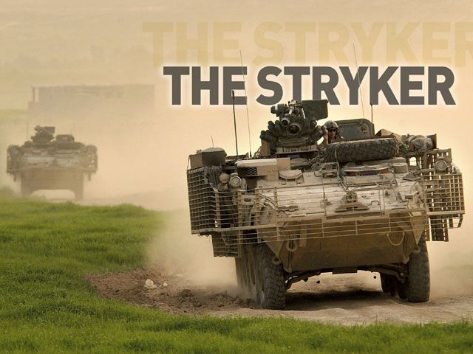
Strike Team
Forensics Toolkit:
Nmap/Nessus - vulnerability scanner programs
Encryption And Cryptanalysis
Forensic Challenges:
Analyze potentially malicious code via static and dynamic methods
Analyze malware to determine its functionality
Based on those analyses, determine ways to mitigate the malware
CTF:
Exploit vulnerable software to discover flags embedded in various systems.

Slide 23
Initial Team Roster
Bradley Cho (IT)
Gabe Glazer (IT)
Kyle Fauerbach (CS) (t)
Seth Cannon (IT) (t)
Nikolay Shopov (CS)
Aleksandre Gelashvili (CS)
Jaryn Villegas (IT) (t)
Alexander Soler (IT) (t)
Gabe Bann (Math)
Jayleene Perez (IT)

Slide 24
Pre Requisite Courses
CS Majors (CS482, IT350)
IT Majors (IT350, IT392, IT460 or CS482)
Cyber Track/Minor (IT460 or PY326 or CS482)

Slide 25
Usmaccdc2018.slack.com Usernames
Kunze, Cole (coleworld) Fauerbach, Kyle (fauer4effect) Cannon, Seth (sethcanflip) Walsh, Pat (patrick.walsh) Wilton, Tyler (tyalwi) Cho, Bradley (chofusionism) O'Neill, Jacob (jake.o'neill) Yarbrough, Gabriel (gabeyarbro) Shopov, Nikolay (Nikoaly Shopov) Gelashvili Aleksandre (wizard_of_ws) Villegas, Jaryn (jaryn.villegas) Soler, Alexander (atgof10) Perez, Jayleene (jayleeneperez) Bann, Gabriel (gabriel.bann) Glazer, Gabriel (glazerthekid)

Slide 26
Questions

